Slide 1
Topological sort
Dr. Yasir | Programming Domain

Slide 2
Graph should be directed and acyclic (DAG)
It is a linear ordering of its vertex such that for every directed edge UV for vertex U to V, U comes before vertex V in the ordering
Every DAG will have atleast one topological ordering
Notes:
Insert a map of your country.

Slide 3
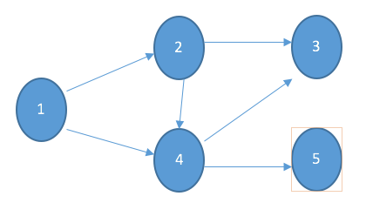
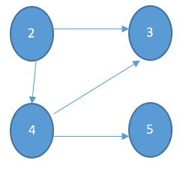
first step: Find indegree
Step 2: choose vertex with indegree 0
Print 1 1--> delete outgoing edges I,e 12 and 14
1 | 0
2 | 1
3 | 2
4 | 2
5 | 1
Notes:
Insert a map of your country.

Slide 4
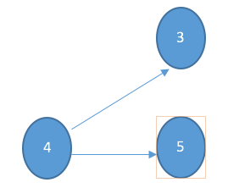
Update indegree
Again select vertex with indegree 0
Print 2 2 --> delete outgoing edges I,e 23 and 24
2 | 0
3 | 2
4 | 1
5 | 1
Notes:
Insert a map of your country.

Slide 5
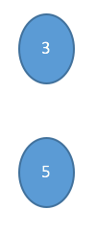
Update indegree
Again select vertex with indegree 0
Print 4 4 --> delete outgoing edges I,e 43 and 45
3 | 1
4 | 0
5 | 1
Notes:
Insert a map of your country.

Slide 6
Select vertex with indegree 0
Select anyone as both have 0 as indegree
Print 3
Print 5.
Printed topololical sort-> 1 2 4 3 5
Another sort can be 1 2 4 5 3
Notes:
Insert a map of your country.

